Slide 1
Daniel Gordon
MP3 Project

Slide 2
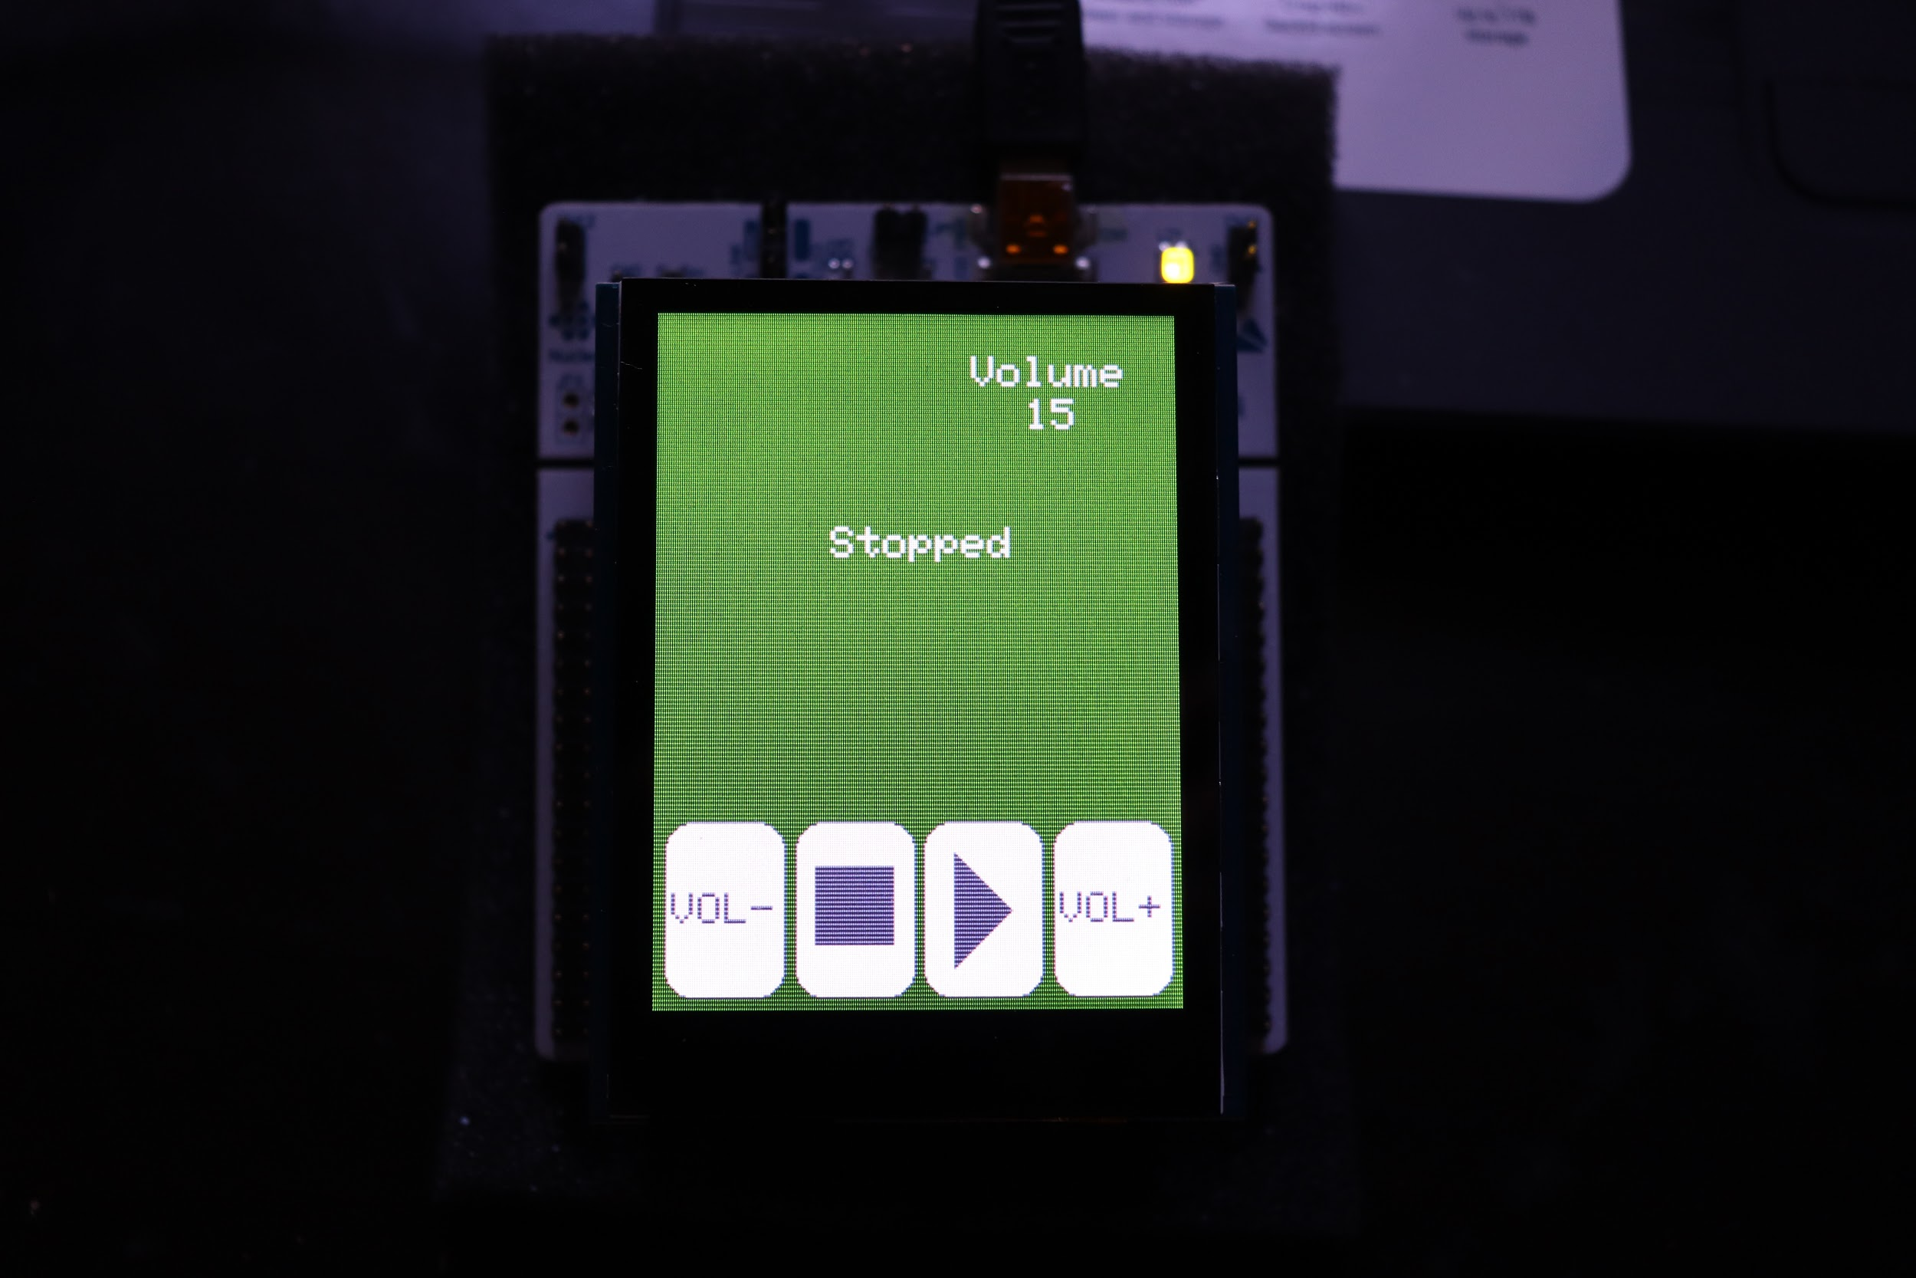
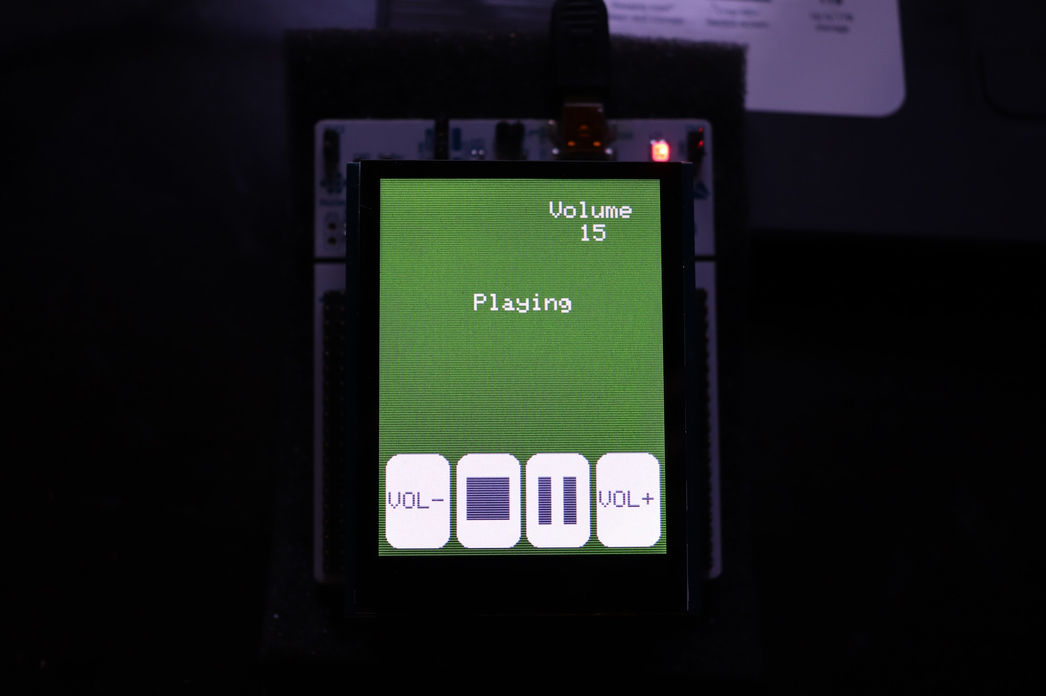
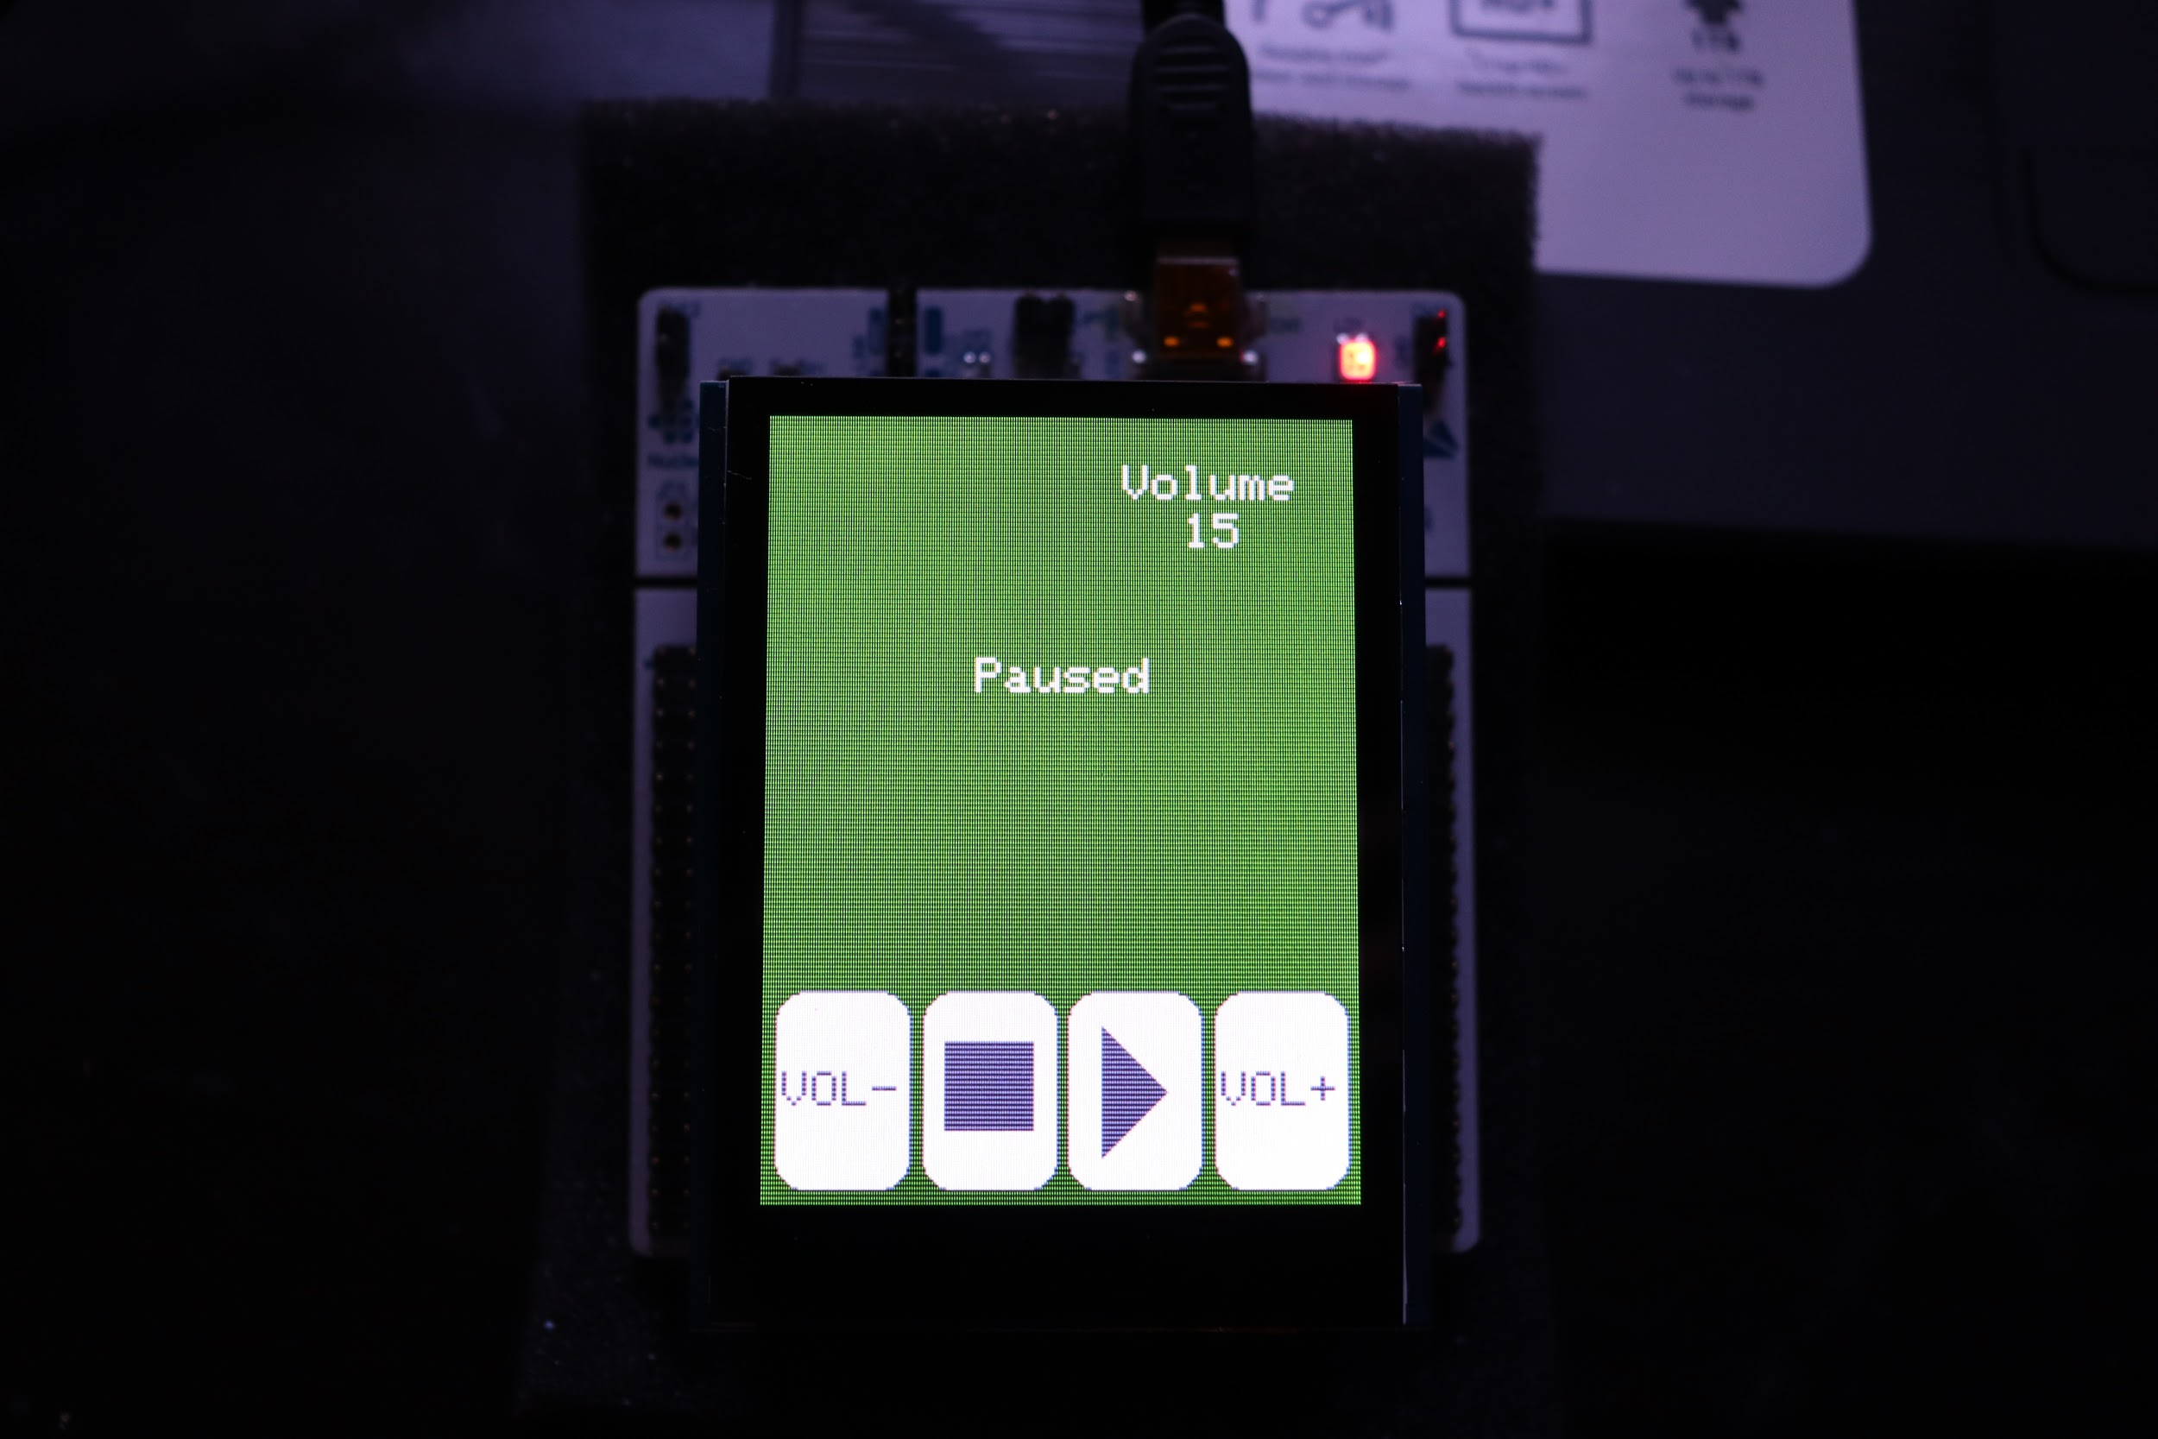
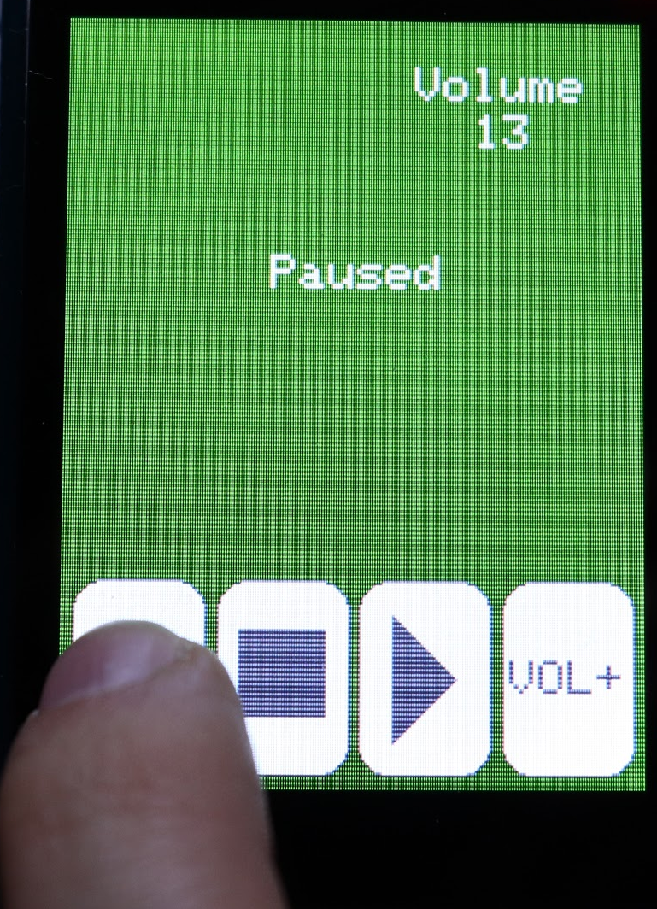
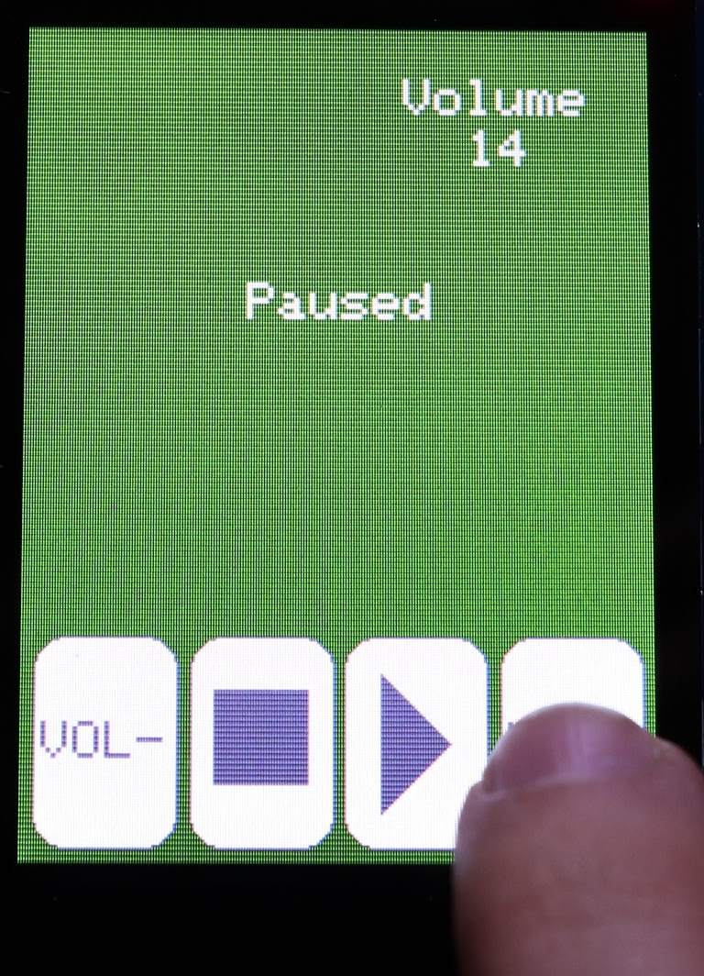
Feature List
Play, Pause, and Stop
Display playback status on screen
Volume control
Display volume levels on screen

Slide 3
Tasks and priority order
Mp3Task() - Highest Priority - Manages the MP3 decoder
DisplayTask() - Next Priority - Manages the LCD screen
TouchInputTask() - Lowest Priority - Manages the touch screen

Slide 4
Dataflow Diagram
Adafruit_FT6206
Touch Screen
Touch Input Data
TouchInputTask()
MP3 Data and
Commands
Stream Message Box
Adafruit_VS1053
MP3 Decoder
Mp3Task()
Requests for more data
Display Queue
DisplayTask()
GFX Functions
Adafruit_ILI9341
LCD Screen

Slide 5
TouchInputTask()
Start
Map TS_Point to buttons and press() corresponding button
Post event to Stream Mailbox once per button press
touched()
TRUE
FALSE
Release all buttons and short delay

Slide 6
Mp3Task()
Start
Accept Message from Stream Mailbox
Implement command and post results in Display Queue
Message Present
No Message
isStreaming?
Yes
End of Song?
Yes
Post STOP command in Stream Mailbox
No
No
500 ms delay
Fill MP3 Decoder buffer and progress song

Slide 7
DisplayTask()
Start
Pend on message from Display Queue
Run DrawText() to update player status and Play Button
Run DrawInt8() to update volume

